Slide 1
High Flow Oxygen Therapy
Bin Du, MD
Medical Intensive Care Unit
Peking Union Medical College Hospital

Slide 2
Conflicts of Interest
Air Liquide
Fisher & Paykel
Mindray

Slide 3
Recommendations for Oxygen Therapy
Cardiac and respiratory arrest
Hypoxaemia (PaO₂ < 7.8 kPa, SaO₂ < 90%)
Hypotension (systolic blood pressure < 100 mmHg)
Low cardiac output and metabolic acidosis (bicarbonate < 18 mmol/L)
Respiratory distress (respiratory rate > 24/min)
Bateman NT, Leach RM. ABC of oxygen: acute oxygen therapy. BMJ 1998; 317: 798-801

Slide 4
Low Flow Devices
Oxygen delivery at flow rate below the normal patient inspiratory flow rate of about 30 lpm
Variable FiO₂
Pruitt WC, Jacobs M. Breathing lessons: basics of oxygen therapy. Nursing 2003; 33: 43-45

Slide 5
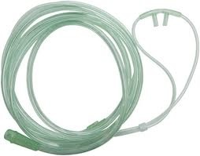
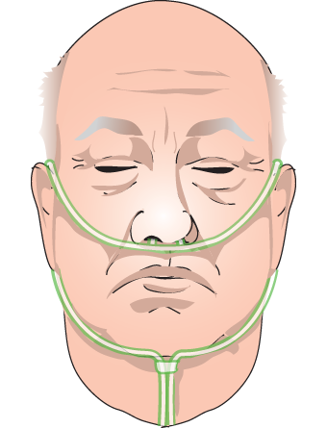
Conventional Low Flow Devices
FiO₂ ≈ 0.3 @ 6 lpm
Conventional O₂ tubing and nasal cannulas
6 L.min⁻¹

Slide 6
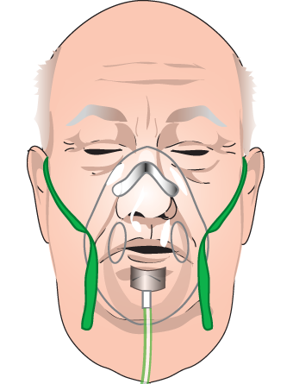
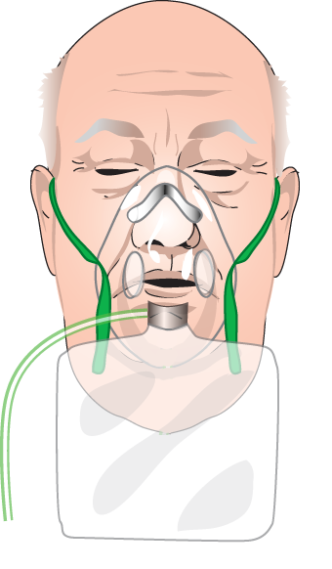
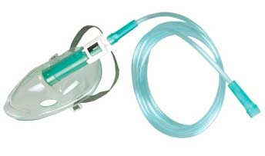
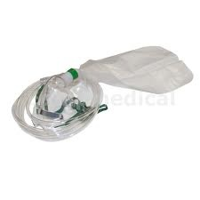
Conventional Low Flow Devices
conventional face mask
face mask with reservoir bag
FiO₂ ≈ 0.6 @ 10 lpm
FiO₂ ≈ 0.8 @ 15 lpm

Slide 7
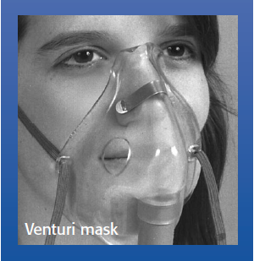
High Flow Devices
Oxygen delivery at rates above the normal inspiratory flow rate
Fixed FiO₂ maintained
FiO₂ | Air/O₂ ratio | Oxygen flow | Total flow
24 | 25:1 | 3 | 78
28 | 10:1 | 6 | 66
35 | 5:1 | 9 | 54
40 | 3:1 | 12 | 48
60 | 1:1 | 15 | 30
Pruitt WC, Jacobs M. Breathing lessons: basics of oxygen therapy. Nursing 2003; 33: 43-45

Slide 8
Humidification of Oxygen Therapy
Isothermic saturation boundary (ISB)
The point at which inspired air reaches 37°C and 100% RH
4 to 5 cm below carina
Downward shift of ISB
Gasping
High minute ventilation
Inhalation of dry and cold air
Artificial airway

Slide 9
Consequence of Inadequate Humidification

Slide 10
Consequence of Inadequate Humidification

Slide 11
High-Flow Nasal Cannula Setup
Nishimura M. High-flow nasal cannula oxygen therapy in adults. J Intensive Care 2015; 3: 15

Slide 12
High-Flow Nasal Cannula (HFNC)
Potential mechanisms of clinical benefit
Favorable effects of heated and humidified gas
High flow rate minimizes entrainment of room air
Increase in ventilatory efficiency
Potential clinical applications
Hypoxemic respiratory failure
Acute cardiogenic pulmonary edema
Postoperative patients
Postextubation

Slide 13
Potential Mechanisms of Clinical Benefit
Favorable effects of heated and humidified gas
Improved comfort and tolerance
Facilitating secretion removal and mobilization
Reduced metabolic cost of breathing
High flow rate minimizes entrainment of room air
Increase in ventilatory efficiency
Washout of nasopharyngeal dead space
PEEP effect
Effects on breathing pattern

Slide 14
Discomfort During Oxygen Therapy vs. HFNC
Cuquemelle E, Pham T, Papon J, et al. Heated and humidified high-flow oxygen therapy reduces discomfort during hypoxemic respiratory failure. Respir Care 2012; 57: 1571-1577

Slide 15
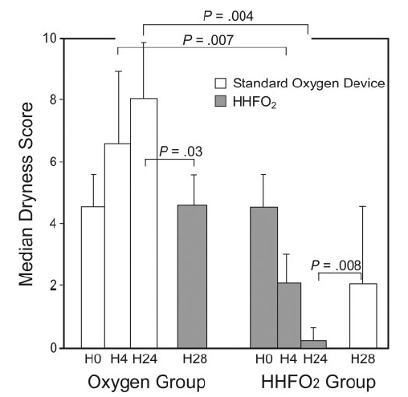
Discomfort During Oxygen Therapy vs. HFNC
Cuquemelle E, Pham T, Papon J, et al. Heated and humidified high-flow oxygen therapy reduces discomfort during hypoxemic respiratory failure. Respir Care 2012; 57: 1571-1577

Slide 16
Dyspnea after Endotracheal Extubation
Rittayamai N, Tscheikuna J, Rujiwit P, et al. High-flow nasal cannula versus conventional oxygen therapy after endotracheal extubation: a randomized crossover physiologic study. Respir Care 2014; 59: 485-590

Slide 17
Respiratory Rate after Extubation
Rittayamai N, Tscheikuna J, Rujiwit P, et al. High-flow nasal cannula versus conventional oxygen therapy after endotracheal extubation: a randomized crossover physiologic study. Respir Care 2014; 59: 485-590

Slide 18
Oxygen Therapy after Extubation
 | Usual Care (n = 171) | HFNC (n = 169)
Patients with SpO₂/FiO₂ ≥ 445 on day 3 | 42.4% (76) | 46.4% (78)
 |  | 0.45
Comfort score (4° after extubation) | 8.1 (2.3) | 7.5 (2.6)
 |  | 0.03
Patients requiring escalation of resp. support | 62.1 (77) | 37.9 (47)
 |  | 0.001
Parke R, McGuinness S, Dixon R, et al. Open-label, phase II study of routine high-flow nasal oxygen therapy in cardiac surgical patients. Br J Anaesth 2013; 111: 925-931

Slide 19
Effects on Comfort and Tolerance
Greater overall comfort with HFNC in
Acute respiratory failure mainly due to pneumonia
Postextubation after cardiac surgery

Slide 20
Lung Mucociliary Clearance after HFNC
Hasani A, Chapman TH, McCool D, et al. Domiciliary humidification improves lung mucociliary clearance in patients with bronchiectasis. Chron Respir Dis 2008; 5: 81-86

Slide 21
Metabolic Cost of Gas Conditioning
E_{total} = E_{g} (37 – T_{amb}) + E_{vap} (44 mg – AH_{amb})
whereas,
E_{total}: the total energy required per liter of inspired gas
E_{g}: the energy required to raise 1 liter of gas 1°C (roughly 1.2 J)
E_{vap}: the energy required to raise 1 mg of water from 37 to 100°C plus the latent heat of vaporization for 1 mg of water (0.263 and 2.260 J, respectively)
T_{amb}: the ambient gas temperature
AH_{amb}: the absolute humidity of ambient gas per liter
Dysart K, Miller TL, Wolfson MR, et al. Research in high flow therapy: mechanisms of action. Respir Med 2009; 103:
1400-1405

Slide 22
Potential Mechanisms of Clinical Benefit
Favorable effects of heated and humidified gas
Improved comfort and tolerance
Facilitating secretion removal and mobilization
Reduced metabolic cost of breathing
High flow rate minimizes entrainment of room air
Increase in ventilatory efficiency
Washout of nasopharyngeal dead space
PEEP effect
Effects on breathing pattern

Slide 23
FiO₂ Reduction after Chest Binding
Hudson mask
 | 4 lpm | 23.8 (17.4 – 30.3)
 | 12 lpm (humidified ‘single jet’) | 17.8 (8.8 – 26.7)
 | 24 lpm (humidified ‘double jet’) | 12.2 (5.0 – 19.3)
Nonrebreathing mask
 | 15 lpm | 4.1 (-3.3 – 11.5)
 | 110 lpm | -0.7 (-4.4 – 3.0)
Vapotherm + nasal prongs
 | 40 lpm (humidified) | -0.3 (-3.1 – 2.5)
Sim MA, Dean P, Kinsella J, et al. Performance of oxygen delivery devices when the breathing pattern of respiratory failure is simulated. Anaesthesia 2008; 63: 938-940

Slide 24
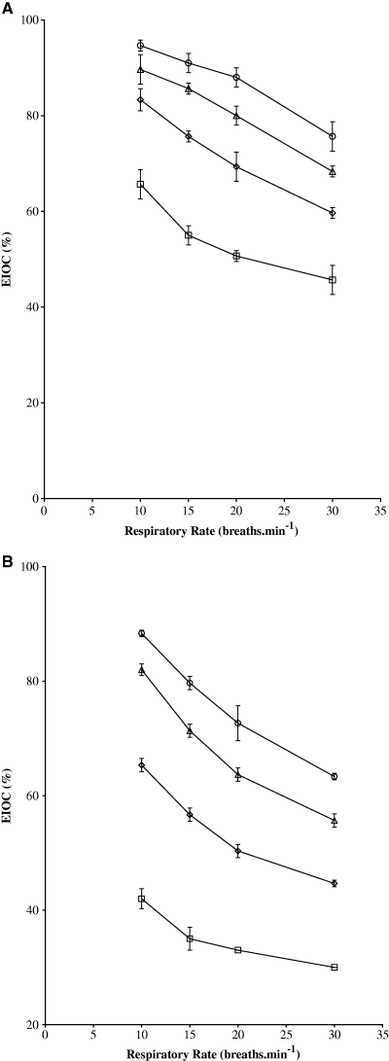
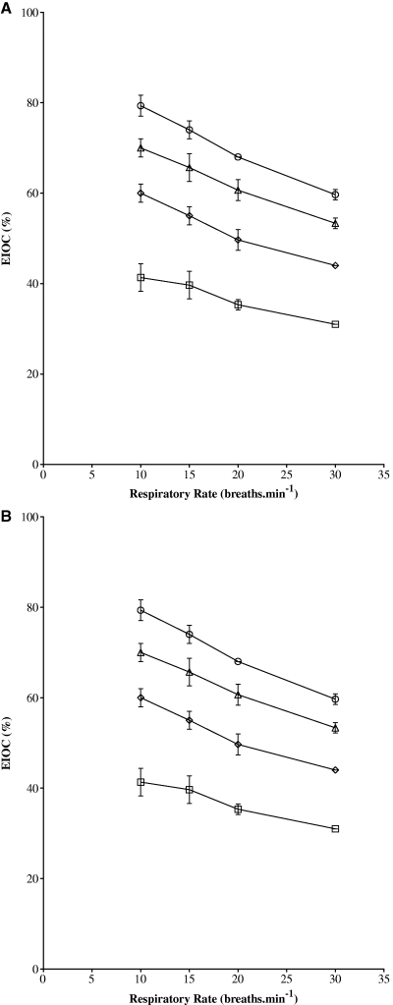
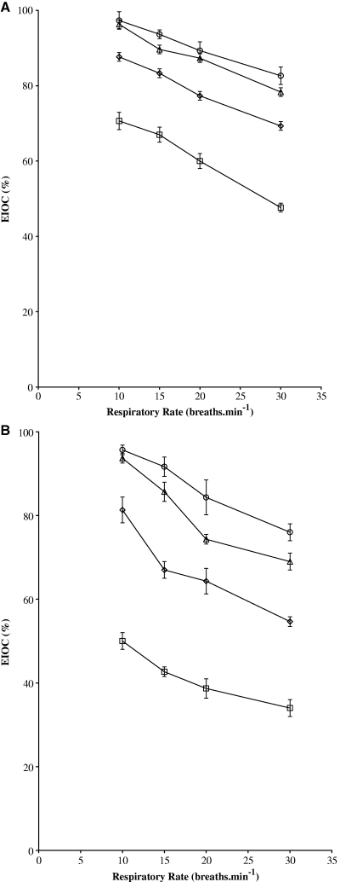
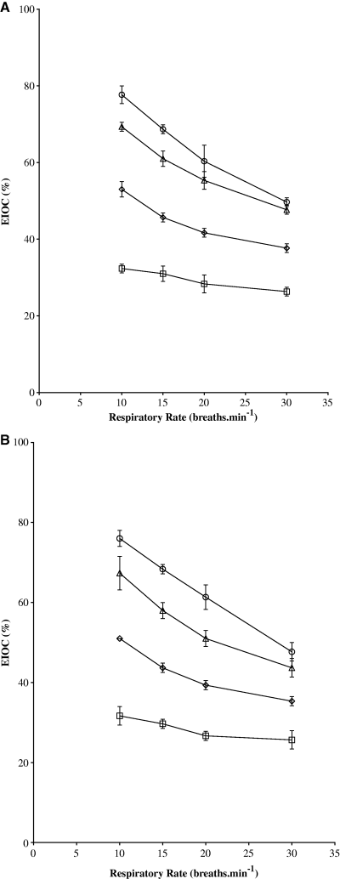
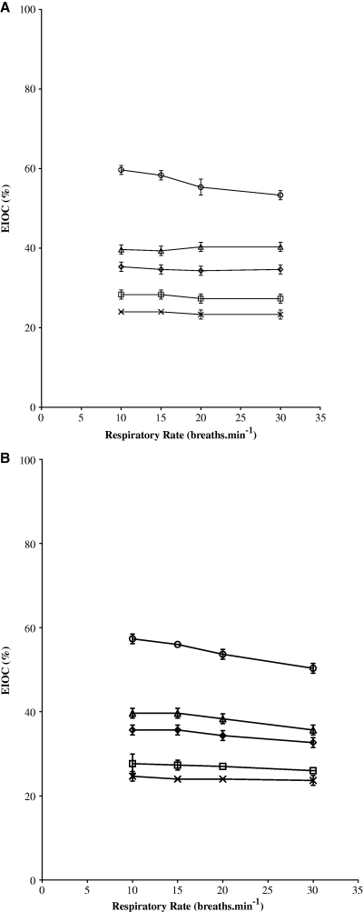
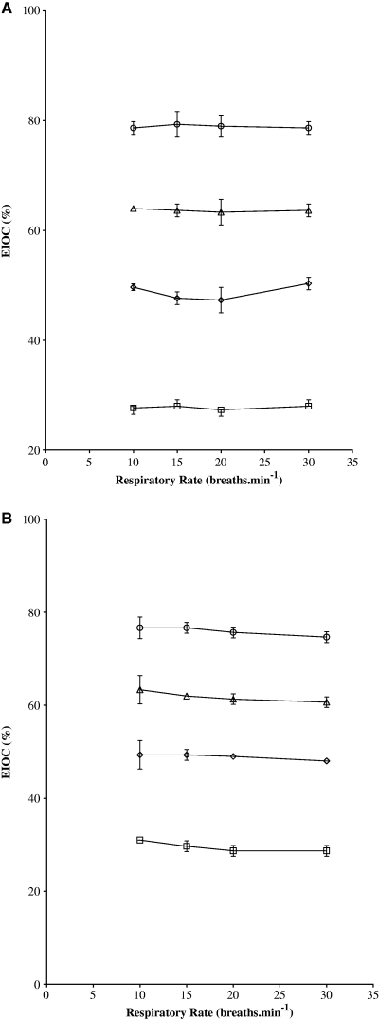
Performance of Oxygen Delivery Devices
Hudson mask
Hudson NRM
Nasal cannulae
Thermovent H2 HME
Venturi
Vapotherm
Wagstaff TAJ, Soni N. Performance of six types of oxygen delivery devices at varying respiratory rates . Anaesthesia 2007; 62: 492-503

Slide 25
Performance of Oxygen Delivery Devices
Ritchie JE, Williams AB, Gerard C, et al. Evaluation of humidified nasal high-flow oxygen system, using oxygraphy, capnography and measurement of upper airways pressure. Anesth Intensive Care 2011: 39: 1103-1110

Slide 26
Potential Mechanisms of Clinical Benefit
Favorable effects of heated and humidified gas
Improved comfort and tolerance
Facilitating secretion removal and mobilization
Reduced metabolic cost of breathing
High flow rate minimizes entrainment of room air
Increase in ventilatory efficiency
Washout of nasopharyngeal dead space
PEEP effect
Effects on breathing pattern

Slide 27
Washout of Nasopharyngeal Dead Space
Ritchie JE, Williams AB, Gerard C, et al. Evaluation of humidified nasal high-flow oxygen system, using oxygraphy, capnography and measurement of upper airways pressure. Anesth Intensive Care 2011: 39: 1103-1110

Slide 28
PEEP Effect During HFNC: Lung Model Study
Ritchie JE, Williams AB, Gerard C, et al. Evaluation of humidified nasal high-flow oxygen system, using oxygraphy, capnography and measurement of upper airways pressure. Anesth Intensive Care 2011: 39: 1103-1110

Slide 29
PEEP Effect During HFNC: Lung Model Study
Ritchie JE, Williams AB, Gerard C, et al. Evaluation of humidified nasal high-flow oxygen system, using oxygraphy, capnography and measurement of upper airways pressure. Anesth Intensive Care 2011: 39: 1103-1110

Slide 30
PEEP Effect During HFNC in Adults
Spontaneous breathing with HFNC in
Healthy volunteers
Stable COPD
Idiopathic pulmonary fibrosis
Postcardiac surgery
Groves N, Tobin A. High flow nasal oxygen generates positive airway pressure in adult volunteers. Aust Crit Care 2007; 20: 126-131

Slide 31
Nasopharyngeal Pressure During HFNC
Parke RL, Eccleston ML, McGuinness SP. The effects of flow on airway pressure during nasal high-flow oxygen therapy. Respir Care 2011; 56: 1151-1155

Slide 32
Nasopharyngeal Pressure During HFNC
Parke RL, Eccleston ML, McGuinness SP. The effects of flow on airway pressure during nasal high-flow oxygen therapy. Respir Care 2011; 56: 1151-1155

Slide 33
Performance of Oxygen Delivery Devices
40 lpm via nose
40 lpm via mouth open
10 lpm via nose
Ritchie JE, Williams AB, Gerard C, et al. Evaluation of humidified nasal high-flow oxygen system, using oxygraphy, capnography and measurement of upper airways pressure. Anesth Intensive Care 2011: 39: 1103-1110

Slide 34
Breathing Pattern During HFNC
Riera J, Pérez P, Cortés J, et al. Effect of high-flow nasal cannula and body position on end-expiratory lung volume: a cohort study using electrical impedance tomography. Respir Care 2013; 58: 589-596

Slide 35
HFNC Increases EELV
Increased airway pressure was significantly correlated with increased lung volume of 25.6%
End-expiratory lung impedance is a surrogate for end-expiratory lung volume
Corley A, Caruana LR, Barnett AG, et al. Oxygen delivery through high-flow nasal cannulae increase end-expiratory lung volume and reduce respiratory rate in post-cardiac surgical patients. Br J Anaesth 2011; 107: 998-1004

Slide 36
Breathing Pattern During HFNC
Corley A, Caruana LR, Barnett AG, et al. Oxygen delivery through high-flow nasal cannulae increase end-expiratory lung volume and reduce respiratory rate in post-cardiac surgical patients. Br J Anaesth 2011; 107: 998-1004

Slide 37
Physiological Effect of HFNC
Effects on oxygenation
Effects on airway pressure
Effects on lung volume
Effects on CO₂ elimination
Appropriate humidification

Slide 38
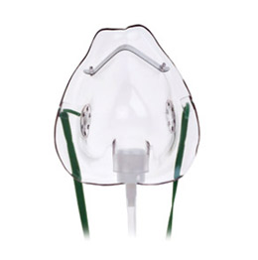
FiO₂ at Different Respiratory Rate
15 lpm
10 lpm
6 lpm
2 lpm
Wagstaff TAJ, Soni N. Performance of six types of oxygen delivery devices at varying respiratory rates. Anaesthesia 2007; 62: 492-503

Slide 39
HFNC vs. Conventional Oxygen Therapy
Ricard JD. High flow nasal oxygen in acute respiratory failure. Minverva Anestesiol 2012; 78: 836-841

Slide 40
Physiological Effect of HFNC
Effects on oxygenation
Effects on airway pressure
Effects on lung volume
Effects on CO₂ elimination
Appropriate humidification

Slide 41
Equation of Motion
volume
Pressure
Flow
Volume
Pressure =
+ Flow × Resistance
Compliance

Slide 42
End-Expiratory Pressure & Inspiratory Flow
Open Mouth
Closed Mouth
Increase in airway pressure: 0.8 cmH₂O per 10 lpm flow
Groves N, Tobin A. High flow nasal oxygen generates positive airway pressure in adult volunteers. Aust Crit Care 2007; 20: 126-131

Slide 43
End-Expiratory Pressure & Inspiratory Flow
Parke RL, Eccleston ML, McGuinness SP. The effects of flow on airway pressure during nasal high-flow oxygen therapy. Respir Care 2011; 56: 1151-1155

Slide 44
Physiological Effect of HFNC
Effects on oxygenation
Effects on airway pressure
Effects on lung volume
Effects on CO₂ elimination
Appropriate humidification

Slide 45
HFNC Increases EELV
Increased airway pressure was significantly correlated with increased lung volume of 25.6%
End-expiratory lung impedance is a surrogate for end-expiratory lung volume
Corley A, Caruana LR, Barnett AG, et al. Oxygen delivery through high-flow nasal cannulae increase end-expiratory lung volume and reduce respiratory rate in post-cardiac surgical patients. Br J Anaesth 2011; 107: 998-1004

Slide 46
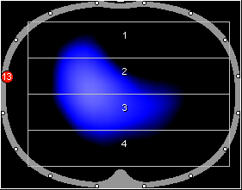
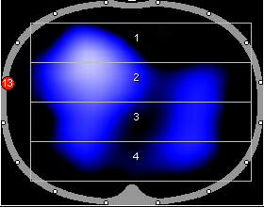
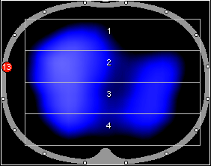
EELV Increases with Flow Rate
OXIDIA study (NCT 02186)
20 patients with postcardiac surgery hypoxemia (PaO₂/FiO₂ < 300) following extubaion
Two groups
NHFO₂ (OptiflowTM) flow rate titrated upwards from 30 to 50 lpm
Conventional oxygen therapy
O₂ nasal cannula
NHFO₂ 30 L.min⁻¹
NHFO₂ 50 L.min⁻¹
NHFO₂ 60 L.min⁻¹
End-expiratory lung impedance is a surrogate for end-expiratory lung volume

Slide 47
Physiological Effect of HFNC
Effects on oxygenation
Effects on airway pressure
Effects on lung volume
Effects on CO₂ elimination
Appropriate humidification

Slide 49
HFNC After Endotracheal Extubation
Maggiore SM, Idone FA, Vaschetto R, et al. Nasal high-flow versus Venturi mask oxygen therapy after extubation: Effects on oxygenation, comfort, and clinical outcome. Am J Respir Crit Care Med 2014; 190: 282-288

Slide 50
Physiological Effect of HFNC
Effects on oxygenation
Effects on airway pressure
Effects on lung volume
Effects on CO₂ elimination
Appropriate humidification

Slide 51
Potential Benefits of HFNC
Mechanism | Clinical Benefit
Small, loose-fitting nasal prongs | Enhanced comfort
Heat and humidification | Enhanced comfort
Increased water content of mucus | Facilitated secretion removal Avoidance of desiccation and epithelial injury
Decreased metabolic cost of breathing | Reduced work of breathing
High nasal flow rate | Reduced inspiratory entrainment of room air if mouth closed; more reliable delivery of FiO₂
Washout of upper airway dead space | Improved efficiency of ventilation Enhanced oxygen delivery
PEEP | Counterbalance auto-PEEP Decreased work of breathing
Spoletini G, Alotaibi M, Blasi F, et al. Heated humidified high-flow nasal oxygen in adults: mechanisms of action and clinical implications. Chest 2015; 148: 253-261

Slide 52
Practical Application of HFNC
Flow rate adjustment
35 lpm as initial setting due to some PEEP effect and good tolerance
5 – 10 lpm increments if RR fails to drop or breathing remains labored
5 – 10 lpm decrements if not tolerated
FiO₂ titration
Rapid improvement in oxygenation if SpO₂ falls substantially below the target level (usually > 90% to 92%)
Further increases in flow rate then used to maintain targeted SpO₂ while FiO₂ lowered to nontoxic levels (≤ 60%)
Weaning criteria
Flow rate ≤ 35 lpm and FiO₂ ≤ 50%
Spoletini G, Alotaibi M, Blasi F, et al. Heated humidified high-flow nasal oxygen in adults: mechanisms of action and clinical implications. Chest 2015; 148: 253-261

Slide 53
HFNC in Acute Respiratory Failure
 | Face Mask (n = 20) | HFNC (n = 20)
Dyspnea | 6.8 (4.1 – 7.9) | 3.8 (1.3 – 5.8)
 |  | 0.001
Mouth dryness | 9.5 (8.0 – 10.0) | 5.0 (2.3 – 7.0)
 |  | < 0.001
Overall comfort | 5.0 (2.3 – 6.8) | 9.0 (8.0 – 10.0)
 |  | < 0.001
Roca O, Riera J, Torres F, et al. High-flow oxygen therapy in acute respiratory failure. Respir Care 2010; 55: 408-413

Slide 54
HFNC in Acute Respiratory Failure
 | Face Mask (n = 20) | HFNC (n = 20)
Total oxygen flow (lpm) | 15.0 (12.0 – 20.0) | 30.0 (21.3 – 38.7)
 |  | < 0.001
Respiratory rate (bpm) | 28 (25 – 32) | 21 (18 – 27)
 |  | < 0.001
PaO₂ (mmHg) | 77 (64 – 88) | 127 (83 – 191)
 |  | 0.002
SpO₂ (%) | 95 (91 – 97) | 98 (96 – 99)
 |  | 0.002
Roca O, Riera J, Torres F, et al. High-flow oxygen therapy in acute respiratory failure. Respir Care 2010; 55: 408-413

Slide 55
HFNC vs. Conventional Oxygen Therapy
Ricard JD. High flow nasal oxygen in acute respiratory failure. Minverva Anestesiol 2012; 78: 836-841

Slide 56
HFNC vs. NIV in Postoperative Hypoxemia
Stéphan F, Barrucand B, Petit P, et al. High-flow nasal oxygen vs noninvasive positive pressure in hypoxemic patients after cardiothoracic surgery: A randomized clinical trial. JAMA 2015; 313: 2331-2339

Slide 57
HFNC vs. NIV in Postoperative Hypoxemia
 | BiPAP PS 8/PEEP 4, FiO₂ 50% (n = 416) | HFNC 50 lpm, FiO₂ 50% (n = 414)
Treatment failure (%) | 21.9% (91) | 21.0% (87)
 |  | 0.003
ICU Mortality (%) | 5.5% (23) | 6.8% (28)
 |  | 0.66
Skin breakdown (%) | 9.9% (40/403) | 3.2% (13/405)
 |  | < 0.001
Stéphan F, Barrucand B, Petit P, et al. High-flow nasal oxygen vs noninvasive positive pressure in hypoxemic patients after cardiothoracic surgery: A randomized clinical trial. JAMA 2015; 313: 2331-2339

Slide 58
HFNC vs. Face Mask vs. NIV in Hypoxemia
Frat J, Thille AW, Mercat A, et al. High-flow oxygen through nasal cannula in acute hypoxemic respiratory failure. N Engl J Med 2015; 372: 2185-2196

Slide 59
HFNC vs. Face Mask vs. NIV in Hypoxemia
Frat J, Thille AW, Mercat A, et al. High-flow oxygen through nasal cannula in acute hypoxemic respiratory failure. N Engl J Med 2015; 372: 2185-2196

Slide 60
HFNC vs. Face Mask vs. NIV in Hypoxemia
 | HFNC (n = 106) | Standard Oxygen (n = 94) | NIV (n = 110)
Intubation at D28 (%) | 38% (40) | 47% (44) | 55% (55)
 |  | 1.45 (0.83 – 2.55) | 1.65 (0.96 – 2.84)
Ventilator-free days | 24 ± 8 | 22 ± 10 | 19 ± 12
 |  | 0.02
ICU Mortality (%) | 11% (12) | 19% (18) | 27% (25)
 |  | 2.55 (1.07 – 6.08) | 2.60 (1.20 – 5.63)
90-day Mortality (%) | 12% (13) | 23% (22) | 28% (31)
 |  | 2.36 (1.18 – 4.70) | 2.33 (1.22 – 4.47)
Frat J, Thille AW, Mercat A, et al. High-flow oxygen through nasal cannula in acute hypoxemic respiratory failure. N Engl J Med 2015; 372: 2185-2196

Slide 61
HFNC in Acute Respiratory Failure
Improved oxygenation compared with standard oxygen therapy but not as much as NIV
Reduced respiratory rate respiratory rate ≥ 30 bpm after initiation after HFNC predicted the need for intubation
Better tolerance than NIV
Wide application in ICU, high-dependency unit, and emergency department
Spoletini G, Alotaibi M, Blasi F, et al. Heated humidified high-flow nasal oxygen in adults: mechanisms of action and clinical implications. Chest 2015; 148: 253-261

Slide 62
HFNC in Acute Heart Failure
 | Before HFNC | After HFNC
PaO₂ (mmHg) | 73.4 ± 4.3 | 98.8 ± 4.76
 |  | < 0.001
PaCO₂ (mmHg) | 53.2 ± 13 | 47.4 ± 8
 |  | 0.109
Respiratory rate (bpm) | 35 ± 2 | 24 ± 3
 |  | 0.002
Heart rate (bpm) | 103 ± 7 | 91 ± 3
 |  | 0.024
Moderate or severe dyspnea | 100% (5) | 20% (1)
 |  | 0.052
Carratalá Perales JM, Llorens P, Brouzet B, et al. High-flow therapy via nasal cannula in acute heart failure. Rev Esp Cardiol 2011; 64: 723-725

Slide 63
HFNC in Acute CPE
Open flooded alveoli
Improve lung compliance and oxygenation
Enhance cardiac function through the afterload-reducing effect
Spoletini G, Alotaibi M, Blasi F, et al. Heated humidified high-flow nasal oxygen in adults: mechanisms of action and clinical implications. Chest 2015; 148: 253-261

Slide 64
HFNC in Postoperative Patients
 | Nasal high-flow oxygen therapy (n = 30) | Standard high-flow face mask (n = 30)
Protocol accomplishment (%) | 90% (26/29) | 56% (15/27)
 |  | 0.006
Treatment failure (%) | 10% (3/29) | 30% (8/27)
 |  | 0.10
Desaturation (%) | 42% (8/19) | 71% (10/14)
 |  | 0.16
Mean desaturation per patient | 1.86 | 0.79
Parke RL, McGuinness SP, Eccleston ML. A preliminary randomized controlled trial to assess effectiveness of nasal high-flow oxygen in intensive care patients. Respir Care 2011; 56: 265-270

Slide 65
HFNC in Postoperative Patients
Postcardiothoracic and vascular surgery
Lower failure rate (escalation to NIV)
Fewer desaturations
Improved thoracoabdominal synchrony
Postcardiac surgery
Reduced respiratory rate
Reduced Borg dyspnea score
Improved or no significant difference in oxygenation
Increased airway pressure
Increased EELV by EIT, especially in patients with a higher BMI
Reduced need for escalation to NIV or intubation
Spoletini G, Alotaibi M, Blasi F, et al. Heated humidified high-flow nasal oxygen in adults: mechanisms of action and clinical implications. Chest 2015; 148: 253-261

Slide 66
HFNC After Endotracheal Extubation
 | HFNC (n = 9) | NRM (n = 8)
Dyspnea score | 1.6 ± 1.2 | 2.9 ± 1.5
 |  | 0.04
Comfort score | 1.4 ± 0.9 | 1.9 ± 1.1
 |  | 0.07
Respiratory rate (bpm) | 19.8 ± 3.2 | 23.1 ± 4.4
 |  | 0.009
Heart rate (bpm) | 89.5 ± 9.5 | 95.4 ± 10.4
 |  | 0.006
Rittayamai N, Tscheikuna J, Rujiwit P, et al. High-flow nasal cannula versus conventional oxygen therapy after endotracheal extubation: a randomized crossover physiologic study. Respir Care 2014; 59: 485-590

Slide 67
HFNC After Endotracheal Extubation
Tiruvoipati R, Lewis D, Haji K, et al. High-flow nasal oxygen vs high-flow face mask: a randomized crossover trial in extubated patients. J Crit Care 2010; 25: 463-468

Slide 68
HFNC After Endotracheal Extubation
Maggiore SM, Idone FA, Vaschetto R, et al. Nasal high-flow versus Venturi mask oxygen therapy after extubation: Effects on oxygenation, comfort, and clinical outcome. Am J Respir Crit Care Med 2014; 190: 282-288

Slide 69
HFNC After Endotracheal Extubation
Maggiore SM, Idone FA, Vaschetto R, et al. Nasal high-flow versus Venturi mask oxygen therapy after extubation: Effects on oxygenation, comfort, and clinical outcome. Am J Respir Crit Care Med 2014; 190: 282-288

Slide 70
HFNC After Endotracheal Extubation
Maggiore SM, Idone FA, Vaschetto R, et al. Nasal high-flow versus Venturi mask oxygen therapy after extubation: Effects on oxygenation, comfort, and clinical outcome. Am J Respir Crit Care Med 2014; 190: 282-288

Slide 71
Potential Clinical Applications of HFNC
Application |  | Benefits
Procedures |  | Enhanced oxygenation during endoscopy
Hypoxemic respiratory failure
 | ARDS | Mild and early
 | Pneumonia | Enhanced oxygenation
 | Idiopathic pulmonary fibrosis | Lower respiratory rate
Cardiogenic pulmonary edema |  | Enhanced oxygenation, reduced dyspnea
Postoperatively
 | Cardiothoracic and vascular | Improved thoracoabdominal synchrony
 | Cardiac surgery | Increased EELV, less escalation of therapy
Postextubation |  | Improved oxygenation and ventilation, enhanced comfort, less displacement of interface
DNR patients |  | Improved oxygenation and respiratory mechanics
Spoletini G, Alotaibi M, Blasi F, et al. Heated humidified high-flow nasal oxygen in adults: mechanisms of action and clinical implications. Chest 2015; 148: 253-261

Slide 72
Predictors of HFNC Failure
Sztrymf B, Messika J, Bertrand F, et al . Beneficial effects of humidified high flow nasal oxygen in critical care patients: a prospective pilot study. Intensive Care Med 2011; 37: 1780-1786

Slide 73
Predictors of HFNC Failure
 | HFNC Failure (n = 9) | HFNC Success (n = 29)
Respiratory rate (bpm) | 29.1 ± 3.8 | 24.6 ± 5.8
 |  | 0.05
SpO₂ (%) | 94.2 ± 7.8 | 97.8 ± 2.6
 |  | 0.0035
Patients with thoraco-abdominal asynchrony (%) | 75% | 10%
 |  | 0.007
Sztrymf B, Messika J, Bertrand F, et al . Beneficial effects of humidified high flow nasal oxygen in critical care patients: a prospective pilot study. Intensive Care Med 2011; 37: 1780-1786

Slide 74
Late HFNC Failure as Prognostic Factor
Kang BJ, Koh Y, Lim CM, et al. Failure of high-flow nasal cannula therapy may delay intubation and increase mortality. Intensive Care Med 2015; 41: 623-632

Slide 75
Late HFNC Failure as Prognostic Factor
Conclusions
Failure of HFNC might cause delayed intubation and worse clinical outcomes in patients with respiratory failure. Large prospective and randomized controlled studies on HFNC failure are needed to draw a definitive conclusions.
Kang BJ, Koh Y, Lim CM, et al. Failure of high-flow nasal cannula therapy may delay intubation and increase mortality. Intensive Care Med 2015; 41: 623-632

Slide 76
HFNC During Endotracheal Intubation
 | HFNC (n = 62) | HFFM (n = 57)
Nadir SpO₂ (%) | 91.5 (80-96) | 89.5 (81-95)
 |  | 0.44
Difficult intubation (%) | 1.6 (1) | 7.1 (4)
 |  | 0.18
IDS score | 3 (2-4) | 3 (2-4)
 |  | 0.63
Ventilator-free days | 14 (0-22) | 5 (0-16)
 |  | 0.09
Compared with HFFM, HFNC as a preoxygenation device did not reduce the lowest level of desaturation.
Vourc’h M, Asfar P, Volteau C, et al. High-flow nasal cannula oxygen during endotracheal intubation in hypoxemic patients: a randomized controlled clinical trial. Intensive Care Med 2015; 41: 1538-1548

Slide 77
HFNC in Postextubation Obese Patients
Corley A, Bull T, Spooner AJ, et al. Direct extubation onto high-flow nasal cannulae post-cardiac surgery versus standard treatment in patients with a BMI ≥ 30: A randomized controlled trial. Intensive Care Med 2015; 41: 887-894

Slide 78
The Other Side of the Moon
HFNC should be stopped early in patients who are at high risk of intubation
Further works should aim at defining the subgroups of patients in which HFNC could be beneficial and identifying the respective role and potential benefit of NIV and HFNC for pre-oxygenation during rapid sequence intubation
HFNC should be of benefit to some selected patients rather than to all patients
Demoule A, Rello J. High flow oxygen cannula: the other side of the moon. Intensive Care Med 2015; 41: 1673-1675

Slide 79
Indication of HFNC in Respiratory Failure
Traditional treatment
low-flow nasal oxygen therapy
standard high-flow oxygen therapy by mask
NIV
Benefits of HFNC
no benefit
more oxygenation and gas flow than necessary
enhanced comfort, more reliable delivery of FiO₂, more efficient ventilation
unlikely to reduce WOB despite better tolerance
not enough positive pressure or ventilator assistance
mild
moderate
severe
severity of hypoxemia
Spoletini G, Alotaibi M, Blasi F, et al. Heated humidified high-flow nasal oxygen in adults: mechanisms of action and clinical implications. Chest 2015; 148: 253-261

Slide 80
Recommended Indication of HFNC
Some evidence for a benefit | Children < 24 months of age with viral bronchiolitis Palliative care Acute hypoxemic respiratory failure with rapid improvement Pre-oxygenation before rapid sequence intubation of non-hypoxemic patients Acute cardiogenic pulmonary edema Extubation of patients after pneumonia or trauma Sleep-related hypoventilation in COPD Acute asthma in children
No evidence for a benefit | Extubation of obese patients after cardiac surgery Pre-oxygenation before rapid sequence intubation of hypoxemic patients Flexible bronchoscopy
Some rationale against the use in clinical practice | Acute hypoxemic respiratory failure with late inbutation Bridge to lung transplant
Benefit remains to be investigated | Acute hypoxemic respiratory failure in immunocompromised patients Pre- or inter-hospital transport AECOPD
Demoule A, Rello J. High flow oxygen cannula: the other side of the moon. Intensive Care Med 2015; 41: 1673-1675

Slide 81
Take Home Message
High-flow nasal cannula as a new method of oxygen therapy
More comfort and tolerance
PEEP effect
Wide clinical application in moderate hypoxemia

